Slide 1
Database Connectivity with Java
Prativa Nyaupane

Slide 2
Recap
JDBC Architecture

Slide 3
Outline
JDBC Architecture
JDBC Driver Types and Configuration
Managing Connections and Statements
Result Sets and Exception Handling
DDL and DML Operations
SQL Injection and Prepared Statements
Row Sets and Transactions
SQL Escapes

Slide 4
JDBC Driver Types
JDBC driver implementations differ because they support various operating systems and hardware platforms running on Java.
The implementation types are distributed in four categories:
Type 1 Driver/ JDBC-ODBC Bridge Driver
Type 2 Driver/ JDBC-Native API
Type 3 Driver/ JDBC-Net pure Java
Type 4 Driver/ 100% Pure Java

Slide 5
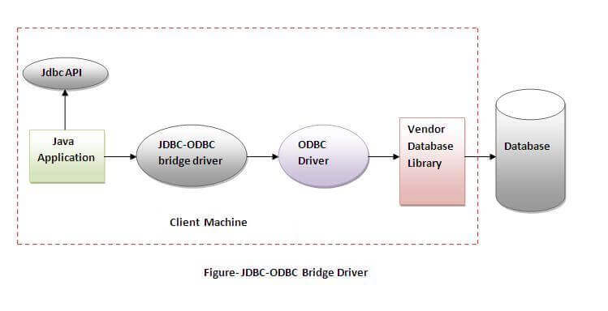
Type 1 Driver/JDBC-ODBC Bridge Driver
A type 1 driver translates JDBC to ODBC(Open Database Connectivity) and relies on an ODBC driver to communicate with the database. ODBC is a standard API for accessing DBMS.
Requires installation and configuration of the ODBC driver.
While JDBC is specific to the Java programming language, ODBC is not tied to any specific programming language. It was originally developed by Microsoft and is widely used on Windows platform.
Java 8 no longer provide the JDBC/ODBC bridge.

Slide 6
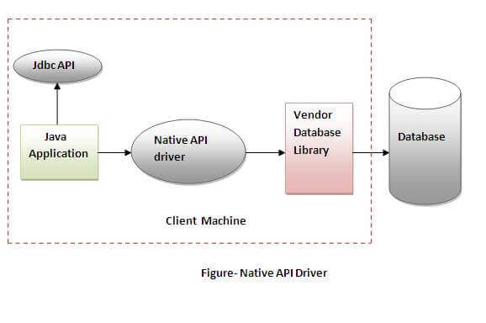
Type 2 Driver/ JDBC-Native API
A type 2 driver is written partly in Java and partly in native code(C/C++), it communicates with the client API of a database.
The driver converts JDBC method calls into native calls of the database API.
Faster than Type 1 drivers as it eliminates the overhead of ODBC.
Requires installation and configuration of native binary code.

Slide 7
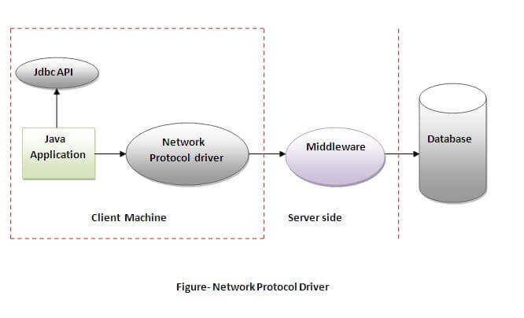
Type 3 Driver/JDBC-Net Pure Java
A type 3 driver is a pure Java client library that uses a database-independent protocol to communicate database requests to a server component, which then translates the request into a database-specific protocol.
This simplifies deployment because the platform-specific code is located only on the server.
No client installation is required.
Server translates the protocol to DBMS function calls.

Slide 8
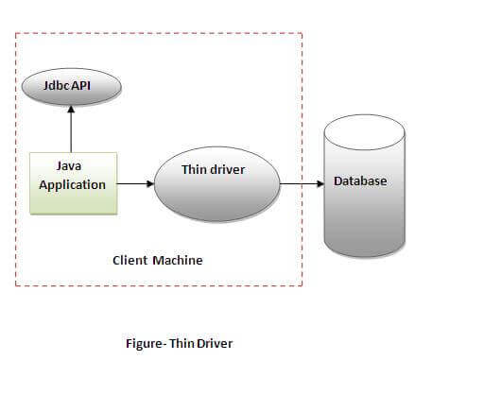
Type 4 Driver/100% Pure Java
A pure java-based driver communicates directly with the vendor’s database in the Type 4 driver through socket connection.
It translates JDBC request directly to vendor-specific database protocol.
It is a pure Java driver, no client installation or configuration is required.
MySQL’s connector/J driver is a Type 4 driver.

Slide 9
Selection of Driver
If we are accessing Oracle, SQL Server or MySQL, the preferred driver is type 4.
If multiple types of databases are accessed at the same time by the Java application, then Type 3 is the preferred driver.
If Type 3 or Type 4 drivers are not available for the database, then Type 2 drivers are useful in this situation.
The Type 1 driver is used for development and testing purpose only. It is not considered to be deployment-level driver.

Slide 10
Intermediate Database Access Server
An Intermediate Database Access Server is a server application that provides an interface between Java applications and multiple databases.
It acts as a middle layer, handling database connection management, query execution, and result retrieval.
The server simplifies database access by providing a unified API for connecting to and interacting with various databases.

Slide 11
Intermediate Database Access Server (contd...)
The server consolidates database connections, manages pooling and caching, and provides load balancing and failover capabilities.
It allows applications to connect to multiple databases using a single connection and provides an interface for database access.

Slide 12
JDBC API
The JDBC API (Application Programming Interface) is a set of Java classes and interfaces that define the standard methods and behaviors for database connectivity.
It allows Java applications to execute SQL statements, retrieve and manipulate data, and manage database connections.
The JDBC API provides a common interface regardless of the specific database being used, enabling portability and flexibility.

Slide 13
Managing Connections and Statements
Connection Management:
JDBC connections represent a connection to a database.
Use DriverManager to establish a connection.
Proper connection handling is crucial to avoid resource leaks.
Connections should be closed using the close() method.
Statement Management:
Statements are used to execute SQL queries.
Types of statements include Statement, PreparedStatement, and CallableStatement.
Statement is a general-purpose interface.
PreparedStatement is precompiled and allows parameterized queries.
CallableStatement is used for calling stored procedures.

Slide 14
Result Sets and Exception Handling
In JDBC, a ResultSet represents the data retrieved from a database after executing a SQL query.
It provides methods to navigate, retrieve, and update data.
Types of result sets include TYPE_FORWARD_ONLY, TYPE_SCROLL_INSENSITIVE, and TYPE_SCROLL_SENSITIVE.
JDBC operations can throw exceptions, such as SQLException, which must be handled.
Common exceptions include SQL syntax errors, connection issues, and data type mismatches.
Proper exception handling ensures graceful error recovery and logging for troubleshooting.

Slide 15
Making a JDBC Application
Making a JDBC application involves writing Java code to connect to a database, execute SQL queries or updates, and process the results.
It typically includes steps such as loading the appropriate database driver, establishing a connection to the database, creating and executing SQL statements, and handling the query results or updates.

Slide 16
Example JDBC Application
Importing the Mysql JDBC driver using Reflection in Java
Creating Database Connection
Class.forName("com.mysql.jdbc.Driver");
Connection con = DriverManager.getConnection(
"jdbc:mysql://localhost:3306/java_jdbc", "root", "root");
Statement stmt = con.createStatement(ResultSet.TYPE_SCROLL_SENSITIVE, ResultSet.CONCUR_UPDATABLE);
ResultSet rs = stmt.executeQuery("SELECT * FROM Persons");
System.out.println(rs.absolute(1));
Creating a Statement to execute queries
Execute the statement
GET first row

